Slide 1

Masterclass

Slide 2
Part 1: Architecture & GraphQL

Slide 3
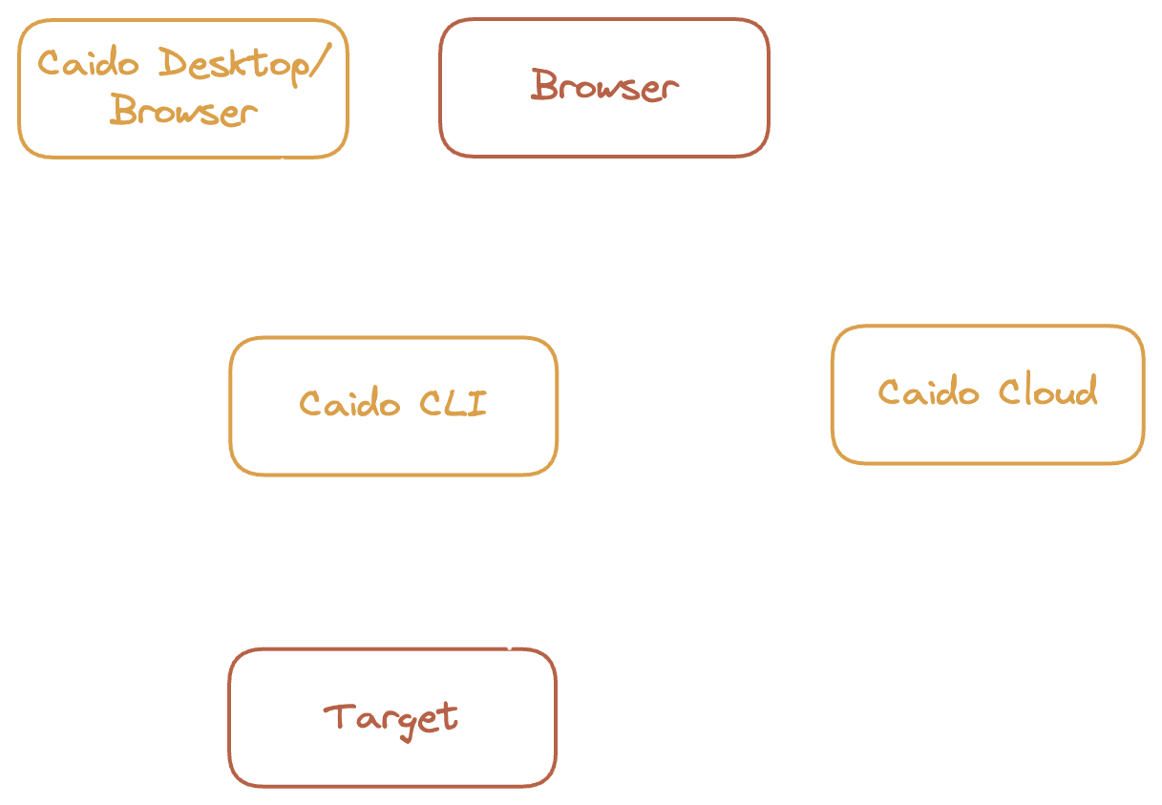
Client/Server
Notes:
Caido operates as a client server
This means that some operations are possible frontend and some require backend stuff
UI: Changing the sidebar
Backend: Sending requests or running workflows

Slide 4
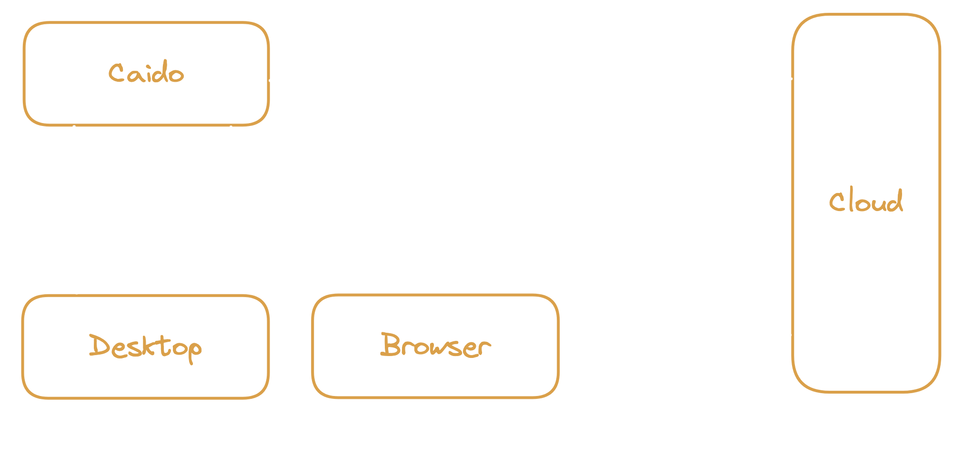
OAuth Authentication
https://docs.caido.io/internals/authentication.html
Notes:
Each Caido instance is an OAuth Client
Device Authorization Grant
When performing the OAuth Flow
Access token (valid 7 days)
Refresh token (valid 3 months)

Slide 5
GraphQL
Schema: https://github.com/caido/caido/blob/main/plugin/schema.graphql
Explorer: https://graphql-kit.com/graphql-voyager/
Playground: http://localhost:8080/graphql
Design
  Mutations
    Format: [present tense verb][Model] (deleteRequest)
    Return: Payload with optional value and error
  Query
    Format: [model(s)] (requests)
    Return: Object or Collection
  Subscription
    Format: [past tense verb][Model] (createdProject)
    Return: Payload with snapshot

Slide 6
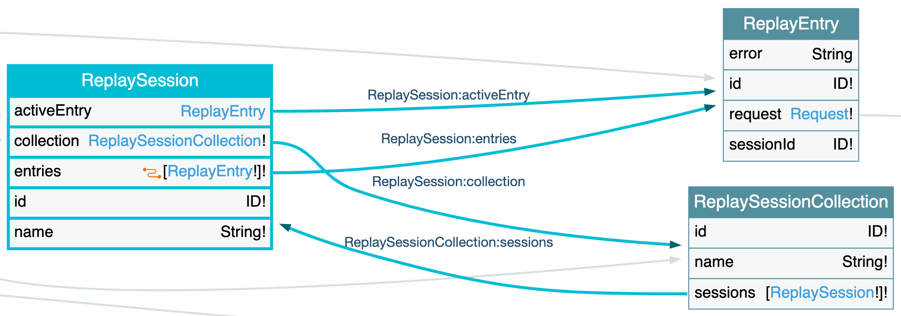
Concepts
Nesting
  Entry => Session => Collection

Slide 7
Concepts
Connection: Used for lazy loading
  Input
    Pagination: Cursor (faster) or Offset
    Filtering: Migrating to HTTPQL
    Ordering & Scope: Custom for Caido
  Output
    Count
    PageInfo
  Example:
    requests(after: String, before: String, first: Int, last: Int, filter: FilterClauseRequestResponseInput, order: RequestResponseOrderInput, scopeId: ID): RequestConnection!
    requestsByOffset(limit: Int, offset: Int, filter: FilterClauseRequestResponseInput, order: RequestResponseOrderInput, scopeId: ID): RequestConnection!

Slide 8
Concepts
Snapshot: Allows you to know if an operation was included in a result set
  Query requests with snapshot 10
  Subscription createdRequest with snapshot 9 (already in requests, ignore)
  Subscription createdRequest with snapshot 11 (not in requests, process)

Slide 9
Why
Push/Pull data in/out of Caido
  Integrations with external tools
Frontend plugin with advanced features
  Adding metadata to requests, displaying the results of a new tool, etc.
Alternate interfaces for specific needs
  Browser extension

Slide 10
Part 2: Backend processing

Slide 11
Why
Current plan: https://github.com/caido/caido/issues/501
Why workflows
  Allowing everybody to create plugins
  Modify existing plugins to fit your needs
  Minimal usage of code, no setup required
Beyond workflows
  We are thinking about offering a “traditional” plugin interface
  Let us know what you need

Slide 12
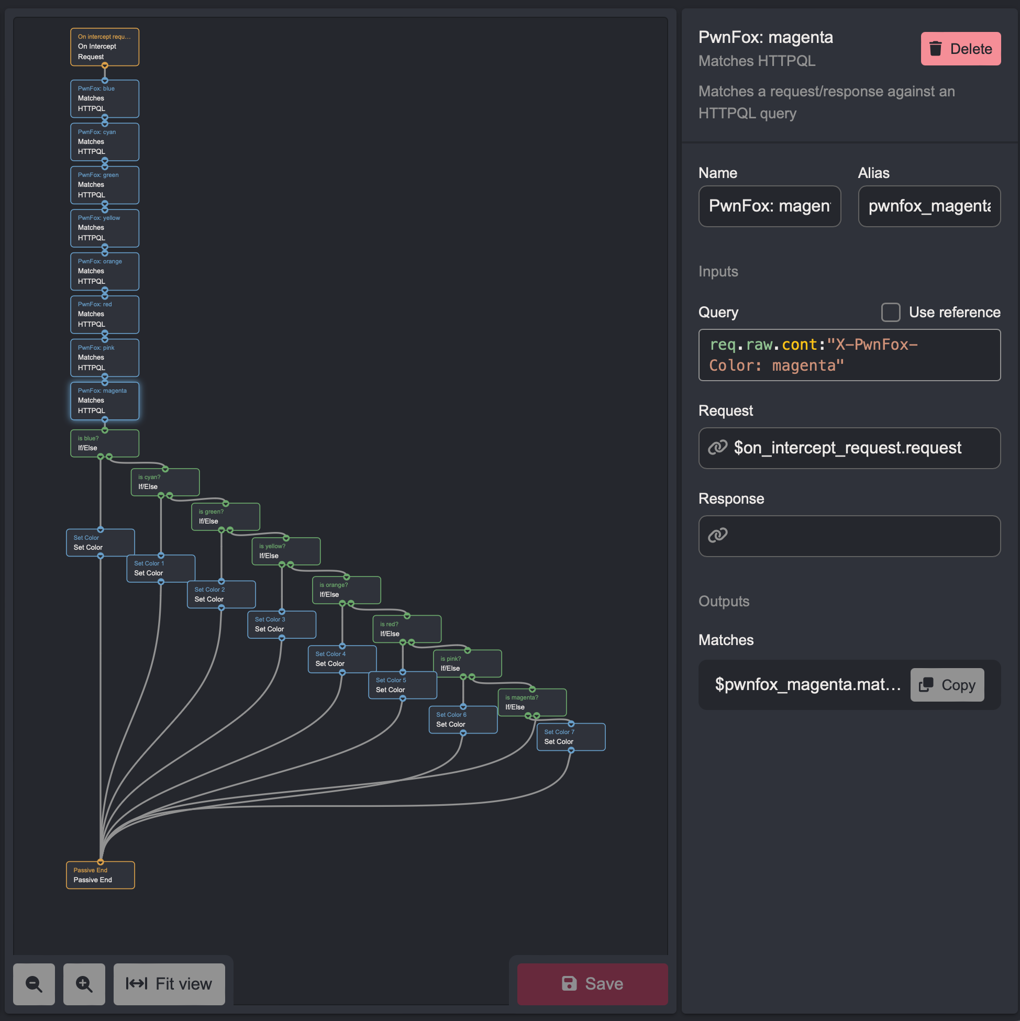
Workflow Anatomy
Execution flow
  Lines on the graph
  Require a Control node to diverge

Slide 13
Workflow Anatomy
Execution flow
  Lines on the graph
  Require a Control node to diverge
Data flow
  Each node has inputs and outputs
  References link them
  Doesn’t require a direct relation

Slide 14
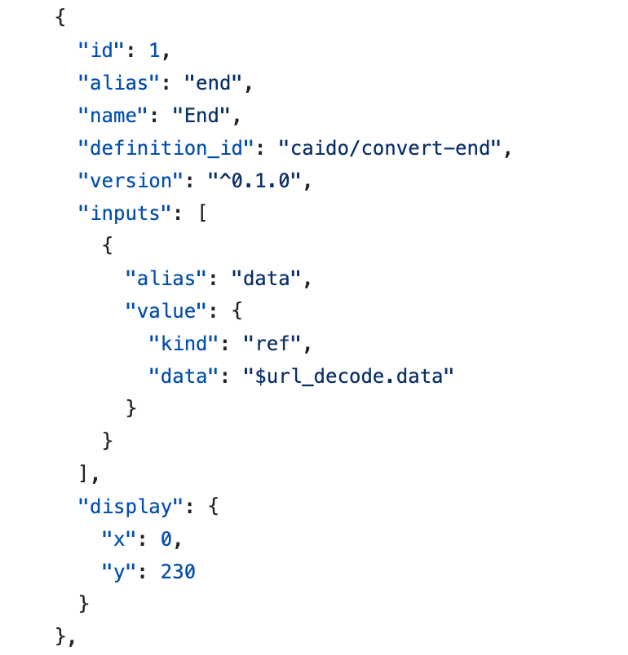
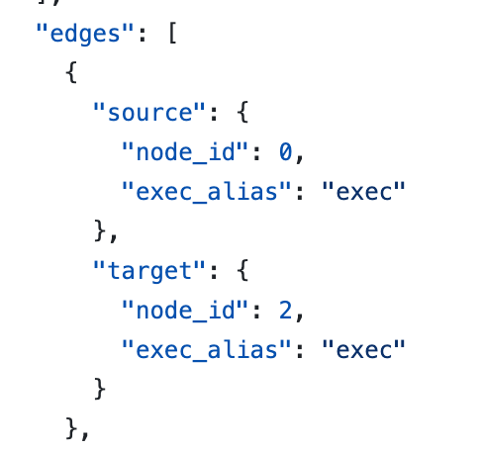
Workflow Anatomy
JSON file representing a graph
  https://github.com/caido/workflows/blob/main/convert/URL%20Decode/URL%20Decode.json
Node
Edge

Slide 15
Convert
Format: Bytes in => Bytes Out
Special Nodes
  Shell: Sends the bytes on the STDIN, reads STDOUT
  Javascript: Run some javascript with QuickJS
    https://bellard.org/quickjs/
  Javascript If: Control node, returns a bool instead (will be replaced eventually)
export function run(input, sdk) {
let parsed = sdk.asString(input);
sdk.console.log(parsed);
return parsed;
}

Slide 16
Passive
Format: Request/Response In => No Output
Only asynchronous for now
Special Nodes
  Shell: Sends the data as environment variables, reads STDOUT
    CAIDO_REQUEST: base64 of request
    CAIDO_URL: Url of the request
    CAIDO_RESPONSE: base64 of response
    *CAIDO_PROJECT: Project name
    *CAIDO_HEADER__HEADER_NAME: For each header
  Matches HTTPQL
    Allows you to write a rule to match request and/or response
    Pipe the result into an If/Else control node.
  JS Node (coming soon)

Slide 17
Part 3: Frontend Plugins

Slide 18
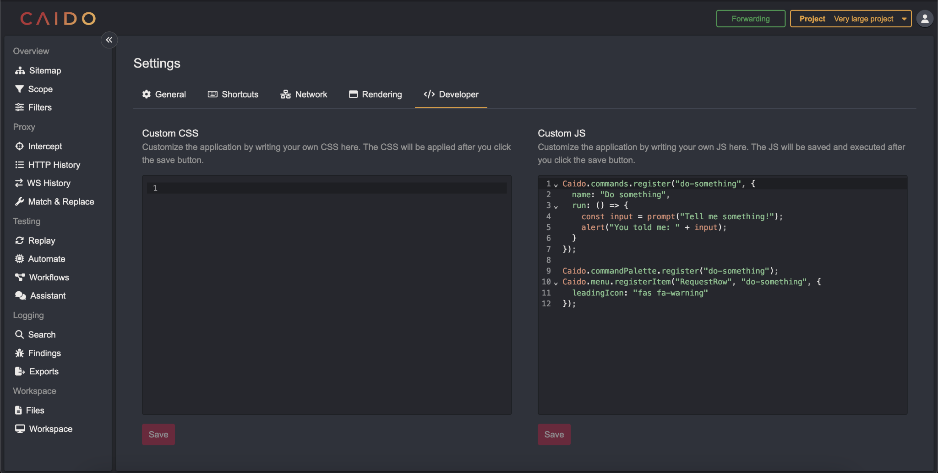
Frontend API
Custom JS

Slide 19
Frontend API
Custom JS
onload = () => {
const js = getCustomJS();
eval(js);
}

Slide 20
Frontend API
Custom JS
Same functionality as the developer console
Use it to manipulate the DOM to your liking
  Add buttons/links
  Perform GraphQL calls
  Show/Hide features
  Fix our bugs ???

Slide 21
Frontend API
window.Caido
Heavily inspired by VSCode’s API
  Uses “Commands” as building blocks for customization
Customize the command palette
Customize context menus
Customize the sidebar
Create/Read/Update/Delete scopes
… more to come

Slide 22
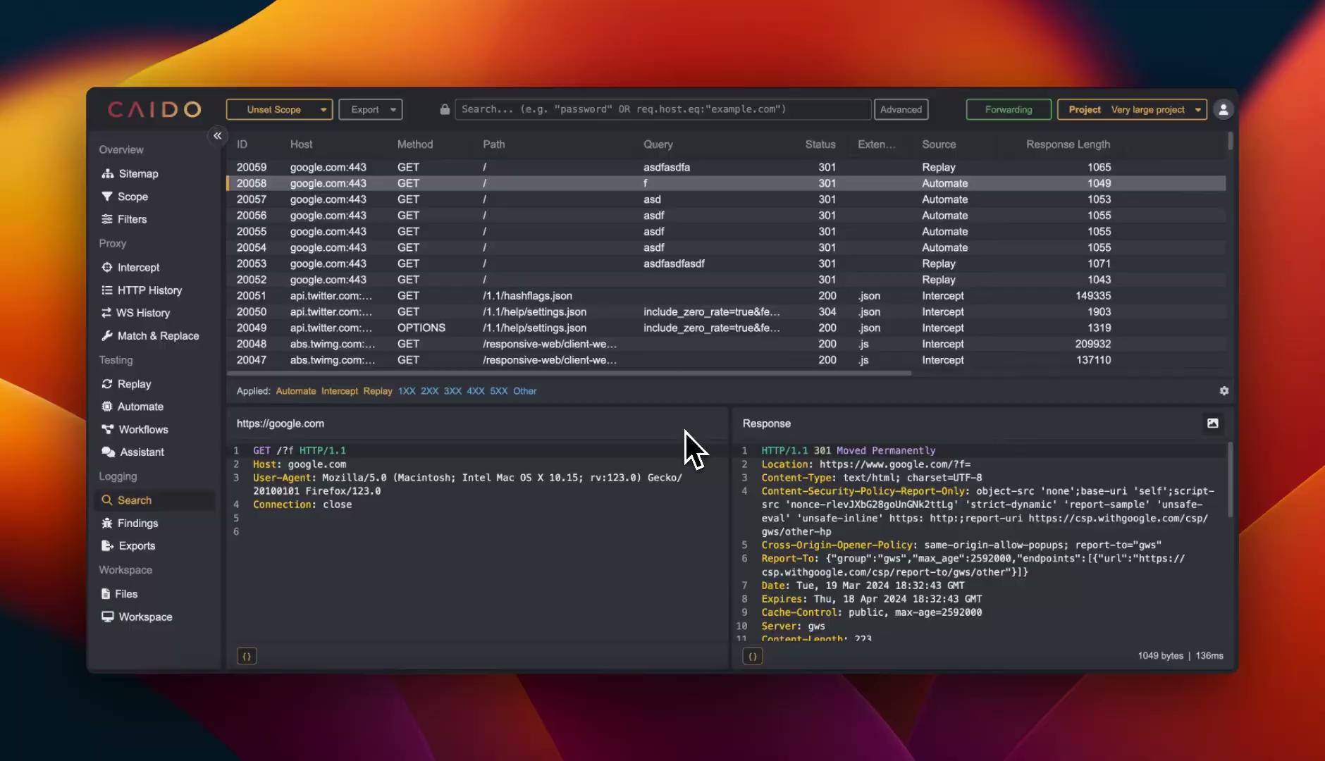
Frontend API

Slide 23
Frontend API
Tips & Tricks
Use the window.Caido variable as much as possible.
When manipulating the DOM…
  Use elements that have the `c-[...]` class prefix
  Don’t query `data-v-[...]` attributes, these are specific to VueJS and are unstable
Add the `?safe` query parameter to load Caido without running the JS plugins
Checkout the API docs here: https://github.com/caido/caido/tree/main/plugin/ui-api

